Slide 1
Water and Wastewater Options for Wood County
Parkersburg, West Virginia

Slide 2
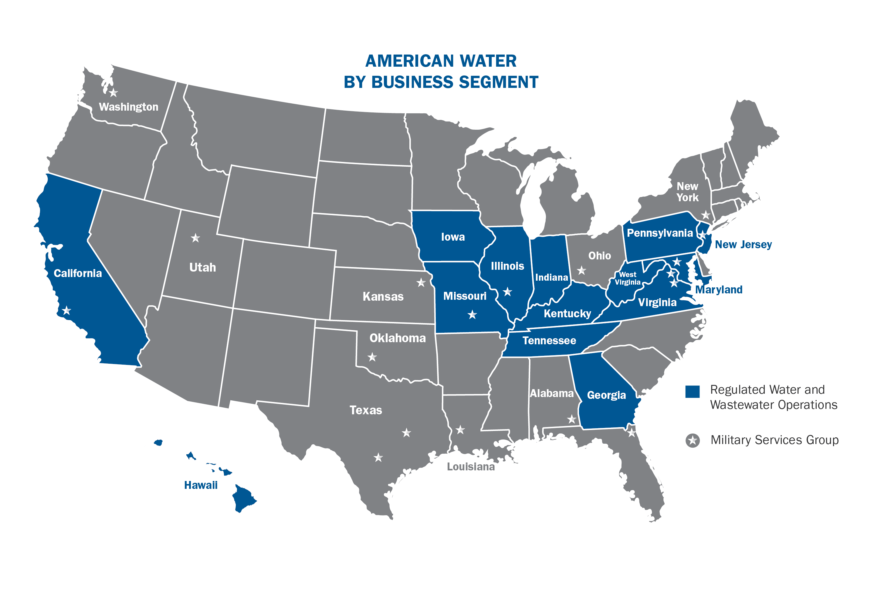
American Water: Who We Are
Founded in 1886, we are the largest and most geographically diverse publicly traded water and wastewater service provider in the United States.
We serve a broad national footprint while maintaining a strong local presence.
We provide services to approximately 15 million people in 46 states.
We employ 6,800 dedicated and active employees and support ongoing community support and corporate responsibility.
We treat and deliver more than one billion gallons of water daily.

Slide 3
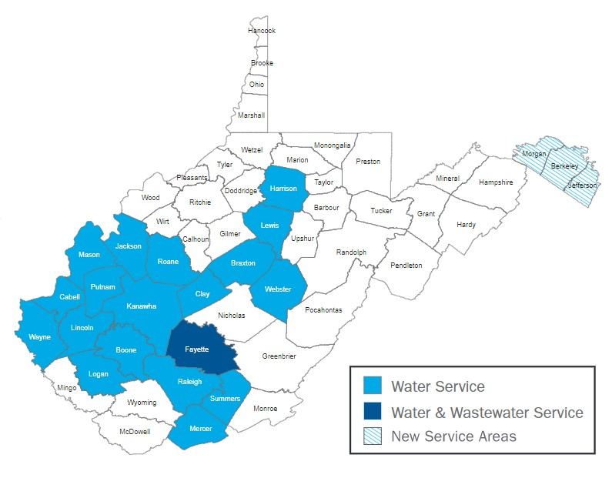
West Virginia American Water Service Area
Our 318 employees serve:
About 30% of the state’s population (more than 545,000 people in 19 counties).
155,000 residential connections, 11,000 commercial customers, 110 industrial customers, 1,100 public authority customers, and 11 sale for resale customers.
1,200 wastewater customers in the Fayetteville area.

Slide 4
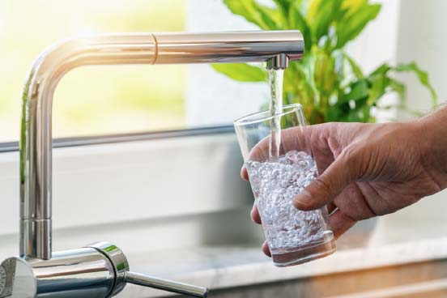
How West Virginia American Water’s Investment Benefits Counties and Municipalities
When West Virginia American Water invests in a water or wastewater system, that investment has multiple benefits:
West Virginia American Water pays off debt associated with the systems.
We spend capital to improve the system we have just acquired and continue to invest to maintain it.
We offer employment to utility staff, helping municipalities or counties to streamline operations.
The purchase of a publicly owned water or wastewater system means proceeds that the city or county can spend however they believe is best for their future.
When WVAW becomes part of a community, we pay B+O taxes just like other companies.

Slide 5
Book Value of Systems*
System | Total Customer Connections | Total Combined Utility Plant (Book Value)
Water Treatment Plants and Distribution Systems | 15,522 | $45,563,000
Wastewater Collection and Treatment Systems | 8,594 | $54,826,000
Total Combined: | 24,116 | $100,389,000
Information taken from 2022 PSC Annual Reports for Central Boaz, Claywood Park, Lubeck, Mineral Wells, and Union Williams PSD’s.

Slide 6
How It Works: The Utility Partnership Process
Due Diligence checklists provided to water / wastewater system
Municipality or PSD gathers information
Site visits
Engineering and financial review
Formal written offer provided to Municipality or PSD
PSC approval
Closing and customer integration
Public Meeting, Approval of ordinance to sell, Signing of Asset Purchase Agreement
WVAW would work closely with the utility to share documents via a secure shared website.
The city or county is under no obligation to accept any offer WVAW might make to purchase the systems.
The costs associated with the due diligence process are paid for entirely by WVAW.

Slide 7
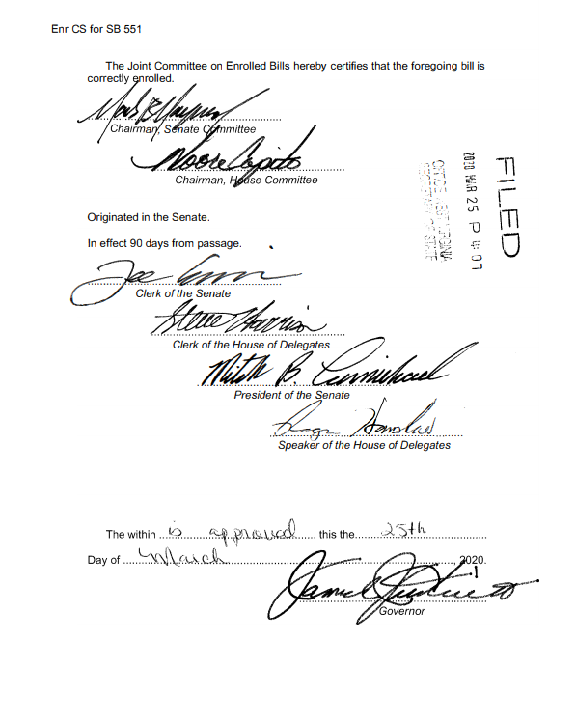
Solutions That Work
WV State Code § 24-2-4g
A modernized evaluation method of determining the value of water or wastewater assets; allows a private utility to pay more to acquire the assets.
Proceeds from a sale ultimately go to the general fund of the municipality or county.
Combined ratemaking for water and wastewater customers.
Allows for proceeds to be spent on more projects such as tearing down dilapidated buildings, purchasing police or fire vehicles, paving projects, reducing taxes, or fulfilling pension liabilities.

Slide 8
Thank you

